Slide 1
Types of Measurement
Direct Measurement : In direct measurement, the meaning of the measurement and the purpose of the processing operation are identical.
Indirect Measurement : In indirect measurement, the meaning of the measurement and the purpose of the processing operation are not same, but are related to each other.

Slide 2
Classification of Instruments
Based on mode of transmission: B. Based on working principle:
Analog a) Manual
Digital b) Automatic
C. Based on source of power: D. Based on function:
Self-operated (Active) a) Indicating type
b) Power-operated (Passive ) b) Recording type
c) Signaling type
d) Registering type
e) Transmitting type
f) Manipulating type

Slide 3
Performance Characteristics
Static Characteristics: These characteristics of an instrument are considered when it is used for measuring a quantity or condition that does not vary with time.
Dynamic Characteristics : These characteristics of an instrument are considered when it is used for measuring a quantity or condition that varies with time.

Slide 4
Static Characteristics
Accuracy
Precision
Sensitivity
Linearity
Resolution
Threshold
Dead zone

Slide 5
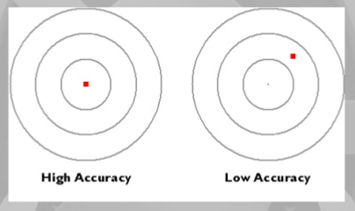
Accuracy
Definition : The accuracy of an instrument is a measure of how close the measured value of the instrument is close to the true value.

Slide 6
The accuracy of an instrument may be expressed in one of the following ways:-
In terms of the measured variable itself
In terms of span of the instrument
In terms of percent of upper-range value
In terms of actual output reading
Static Error : It is the difference between the actual value indicated by the instrument and the true value of the quantity being measured.
Static Error = Instrument reading – True value

Slide 7
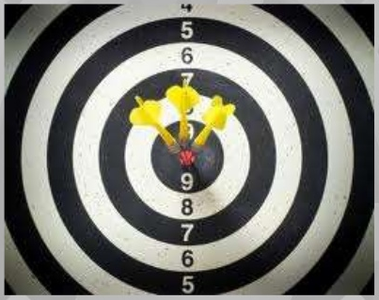
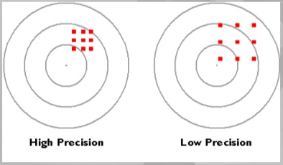
Precision
Definition : It is the ability of a measuring instrument to give identical responses for repeated applications of the same value of the measured quantity under the same conditions of use.

Slide 8
Precision is sometimes stratified into:-
Repeatability : It is the degree of closeness with which a quantity can be repeatedly measured by using the same instrument and operator, and repeating during a short time period.
Reproducibility : It is the extent of variation arising in the measured value of a quantity using the same measurement process among different instruments and operators, and over longer time periods.
Drift : The gradual shift in the indication or record of the instrument over an extended period of time, during which the true value of the variable does not change is referred to as drift.

Slide 9
Different kinds of drifts are as follows:-
The entire instrument calibration may gradually shift by the same amount. This is called as zero drift that can be easily corrected by shifting the pointer position.
In case of span drift, calibrations from lowest value to the highest value get shifted by proportional amount. Hence, higher calibrations get shifted more than the lower calibrations.
In some instruments, only a certain portion of the calibration gets shifted while the remaining portion of the scale remains unaffected.

Slide 10
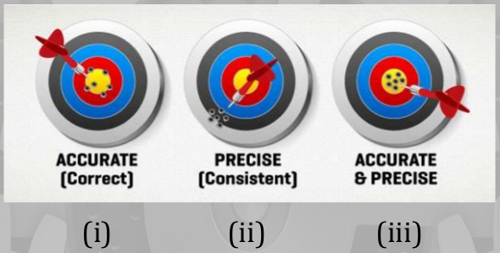
Difference between Accuracy and Precision

Slide 11
Sensitivity
Definition : It is the response of an instrument denoted by a change in the output reading corresponding to a change in the value of the input variable. (This relationship may be linear or non-linear).
An instrument with a large sensitivity denotes even a slight change in the input.

Slide 12
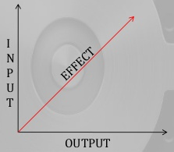
Linearity
Definition : It is the relationship between the change in output corresponding to the change in input variable, when they are in direct proportion.
Most instruments are specified to function over a particular range and the instruments can be said to be linear when incremental changes in the input and output are constant over the specified range.

Slide 13
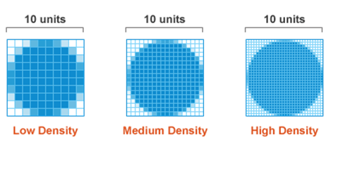
Resolution
Definition : It is defined as the smallest input increment change that gives some small but definite numerical change in the output.

Slide 14
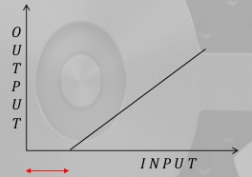
Threshold
Definition : If the instrument input is very gradually increased from zero, there will be a minimum value required to give a detectable output change. This minimum value defines the threshold of the instrument.

Slide 15
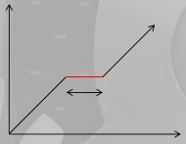
Dead Zone
Definition : This is the range of different input values over which there is no change in the output value.
This is produced by friction, backlash or hysteresis in the instrument.

Slide 16
Instrument Description
Operating Principle
Construction (indicating & sensing elements)
Working (instrument & working substance)
Calibration
Performance Characteristics
Advantages, Limitations, Applications

